Slide 1







Analysis of 2019 Stack Overflow Developer Survey
Phone Sett Paing
April 2022

Slide 2



OUTLINE
Executive Summary
Introduction
Methodology
Results
Visualization – Charts
Dashboard
Discussion
Findings & Implications
Conclusion
Appendix

Slide 3

EXECUTIVE SUMMARY
This presentation summarize key findings from analyzing 2019 Stack Overflow Developer Survey Results dataset.
Current Technology Usage ( e.g., popular language, database, platform or web frame among developers)
Future Technology Trend ( e.g., most language, database, platform or web frame that developers want to work in over the next year)
Demographics ( e.g., gender gap among developers, age groups of developers)
These findings are relevant in order to keep pace with changing technologies, remain competitive and identify future skill requirements for the organization.

Slide 4

INTRODUCTION
With ever changing technologies in the field of IT, new problems will emerge that require new solutions.
As a global IT and Business consulting services frim, we must be able to provide expertise in IT solutions to these emerging new problems to remain competitive.
To solve these problems, we need teams of highly experienced IT consultants in these changing technologies and skills.
This analysis will identify future skill requirements and give insights and trends in the following:
What are the top programming languages in demand?
What are the top database skills in demand?
These findings will help HR Professionals in identifying which future skills are needed in the organization and help developers in deciding which skills to pursue.

Slide 5

METHODOLOGY
Data Source: The subset (provided by IBM) of original data set (2019 stack overflow developer survey results) from Stack Overflow, a popular website for developers. This randomized subset contains around 1/10th of original data set.
Data Exploration: Find out number of rows, columns and identify the data types of each column to get familiar with the data.
Data Wrangling: Identify and remove duplicate values, identify and impute missing values and normalize data.
Exploratory Data Analysis: Identify the distribution of data in the dataset, identify and remove outliers from the dataset and identify correlation between features in the dataset.
Data Visualization: Visualize the distribution of data, relationships in data, composition of data and comparison of data using various Python libraries and using Cognos Dashboard Embedded (CDE) through IBM Cloud to create the following dashboard:
Current Technology Usage
Future Technology Trend
Demographics

Slide 6

RESULTS
The initial subset data contain 11552 rows and 85 columns.
After removing duplicates, imputing missing values and removing outliers, the data contain 10519 rows and 85 columns.
The survey was collected from developers in 135 countries world wide
Survey Respondents had a median age of 29 and majority of respondents were male.
Medium Annual Salary: $52,704 USD
Average Annual Salary: $59,883 USD
Annual Salary and Age were positively correlated: r = .40

Slide 7
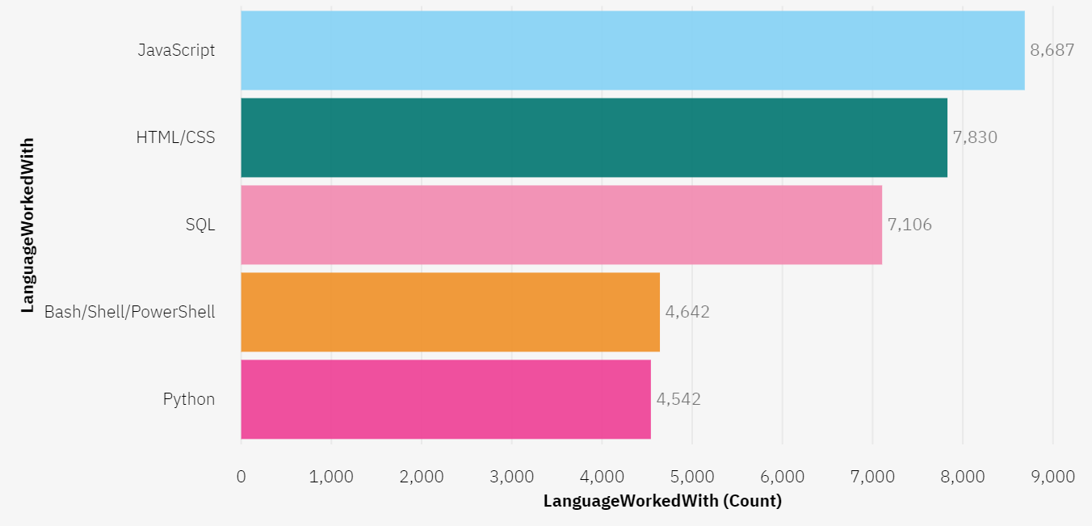
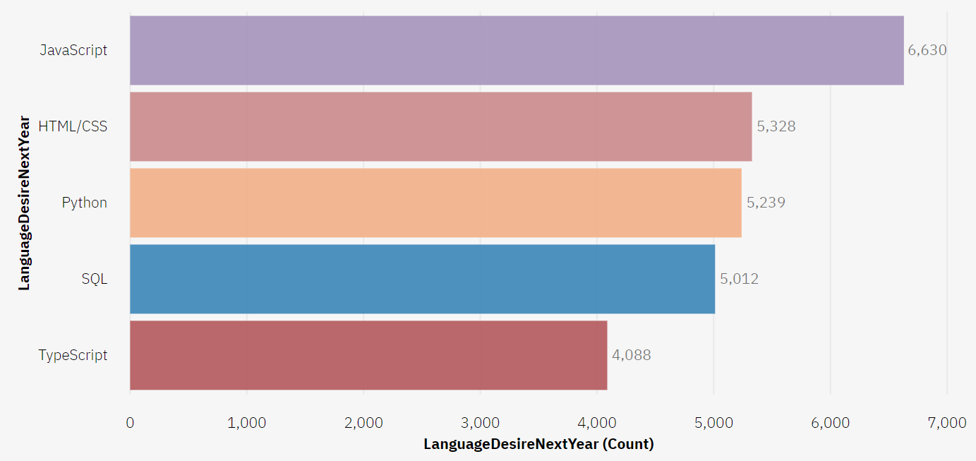
PROGRAMMING LANGUAGE TRENDS
Top 5 Popular Languages Current Year
Top 5 Languages Desired Next Year

Slide 8
PROGRAMMING LANGUAGE TRENDS - FINDINGS & IMPLICATIONS
Findings
JavaScript and HTML/CSS are the top 2 popular languages for current year and next year.
SQL popularity will drop in next year but will still remain in top 5 popular languages.
Decreasing interest in Bash/Shell/PowerShell while interest in TypeScript increases.
Massive increase of interest in Python.
Implications
JavaScript and HTML/CSS remain as the most popular language for Web Development.
SQL will remain as most used language for querying and storing of data.
Increase of interest in Python, due to the increase of popularity in Data Science, Machine Learning and Deep Learning AI.

Slide 9
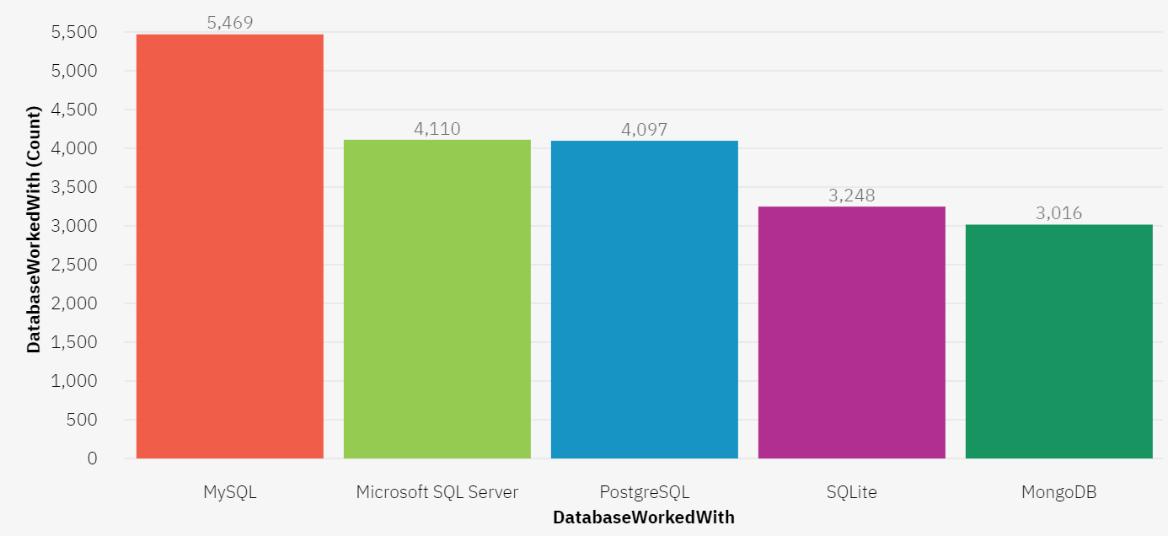
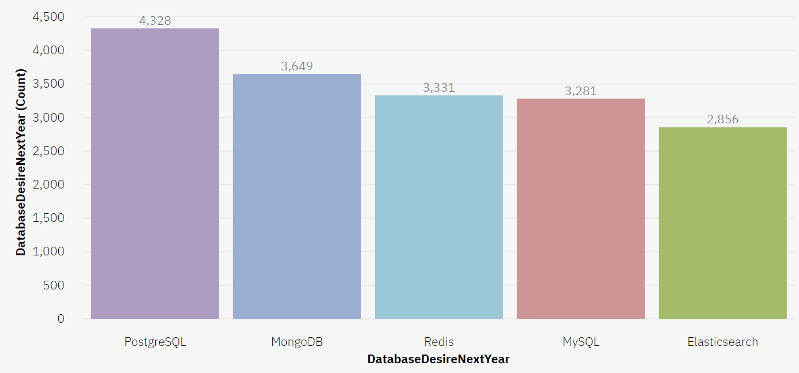
DATABASE TRENDS
Top 5 Popular Database Current Year
Top 5 Database Desired Next Year

Slide 10
DATABASE TRENDS - FINDINGS & IMPLICATIONS
Findings
Increasing interest in PostgreSQL and MongoDB.
Decreasing interest in MySQL.
Lost of interest in Microsoft SQL Server and SQLite while gain of interest in Redis and Elasticsearch.
Implications
Developers prefer to use open-source databases.
Increasing interest in NoSQL databases, due to an increase need in handling structure and non-structure data for social media and web applications.
Increase of interest in real-time databases, due to an increase popularity in Internet of Things (IoT) devices.

Slide 11

DASHBOARD
The following link contains the full, interactive Cognos dashboard:
Click here to open the dashboard (Ctrl+Click)
Screenshots of the dashboard are shown in the next three slides.

Slide 12
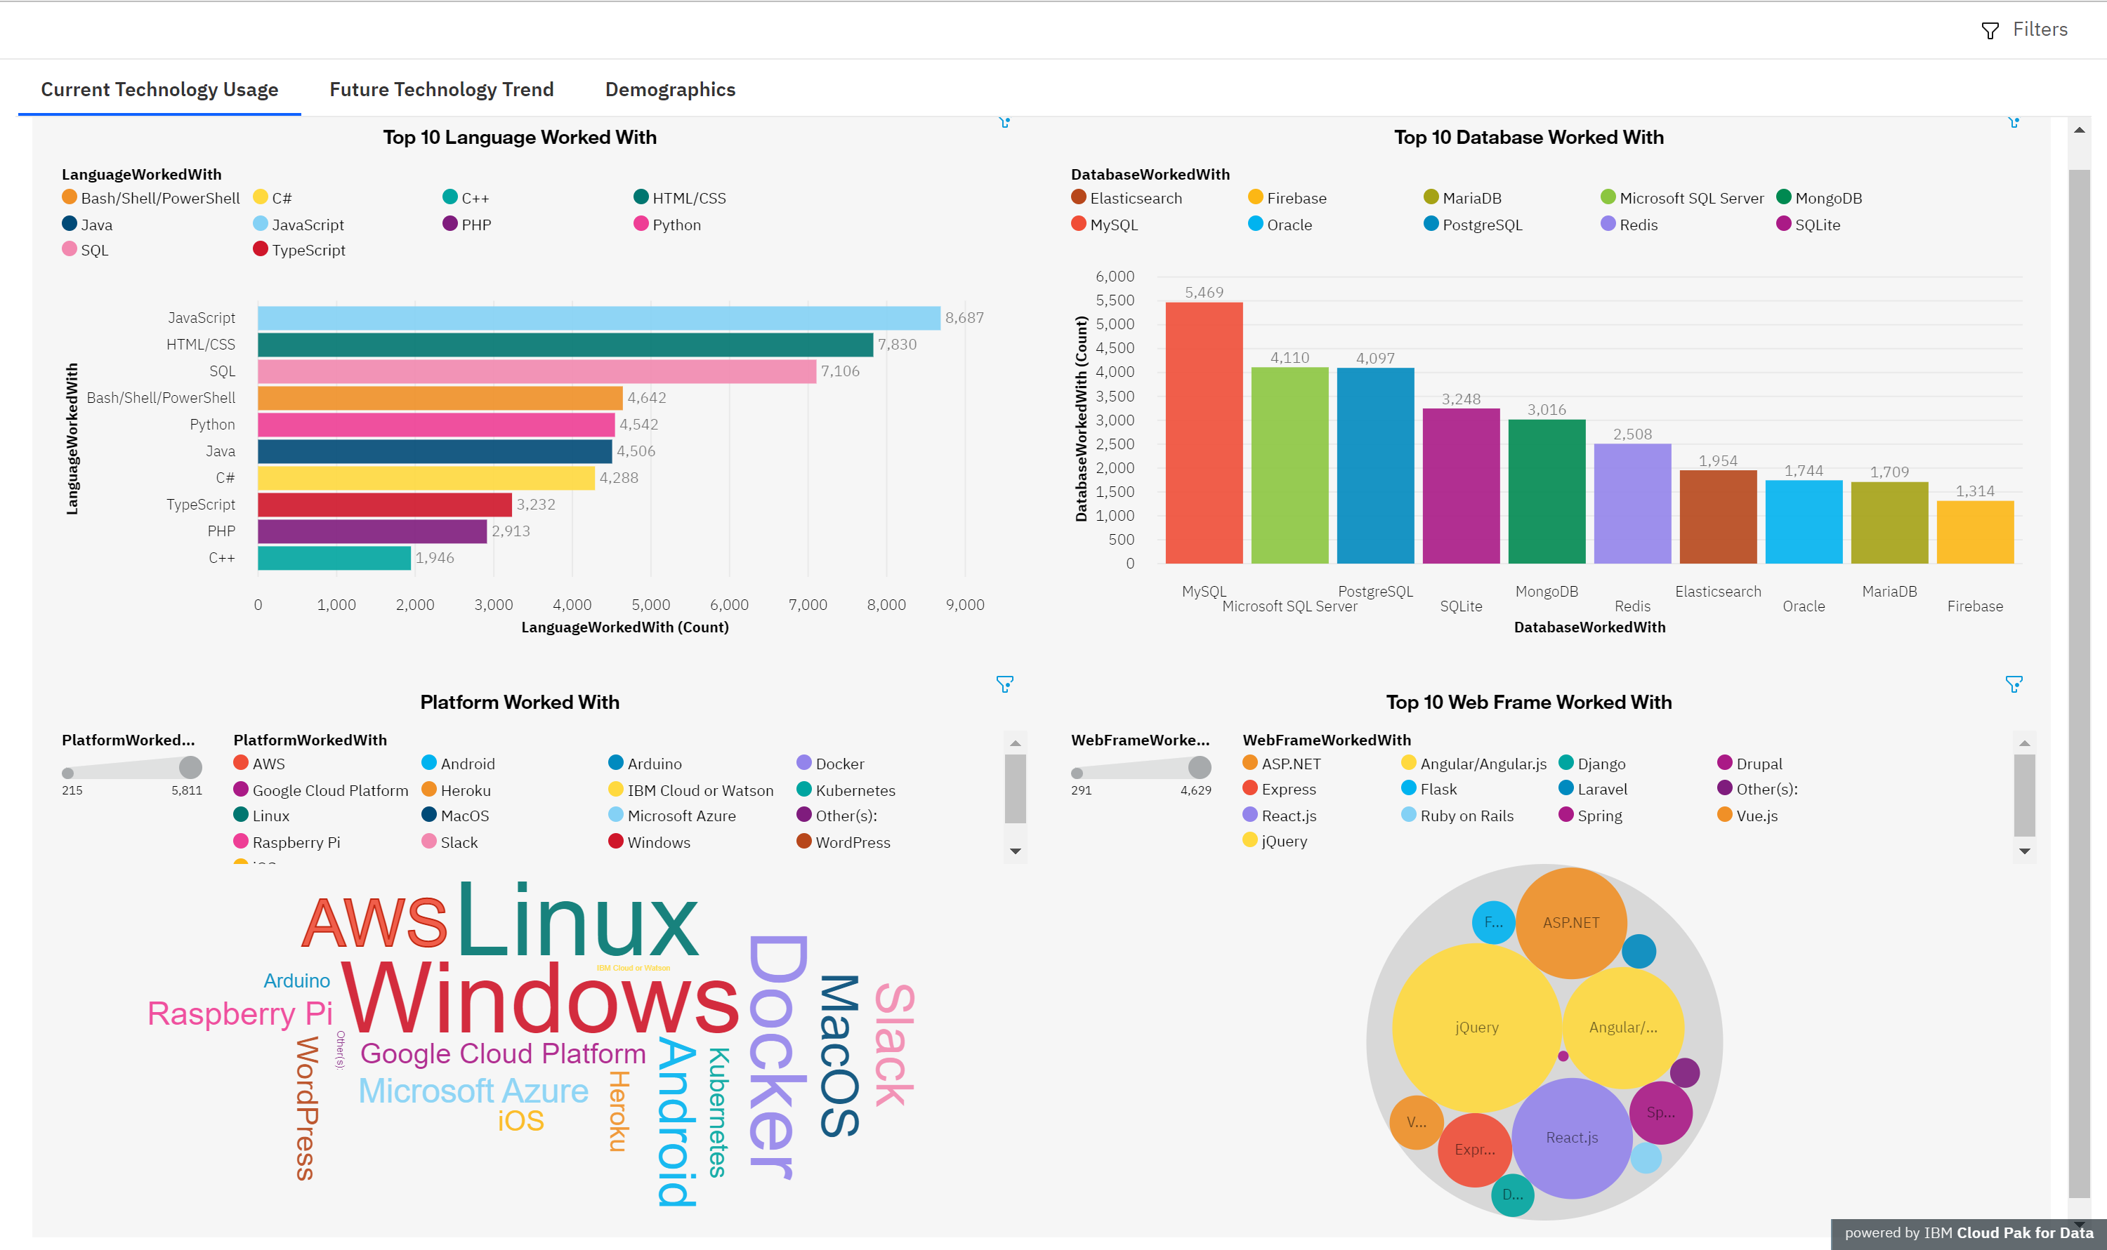
DASHBOARD A: CURRENT TECHNOLOGY USAGE

Slide 13
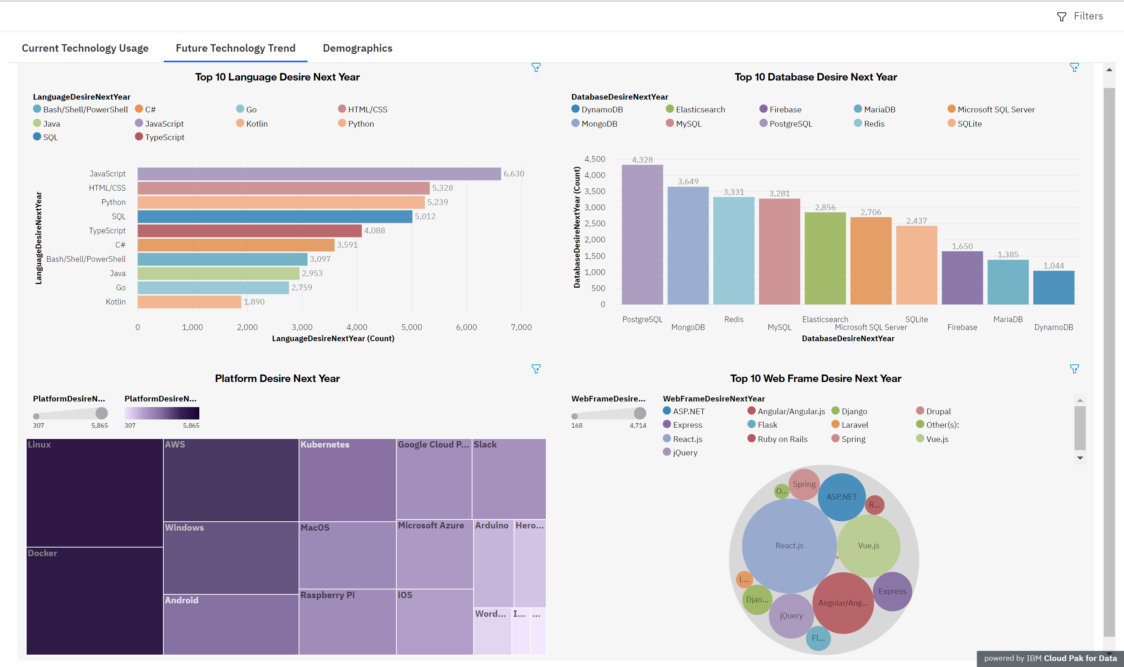
DASHBOARD B: FUTURE TECHNOLOGY TREND

Slide 14
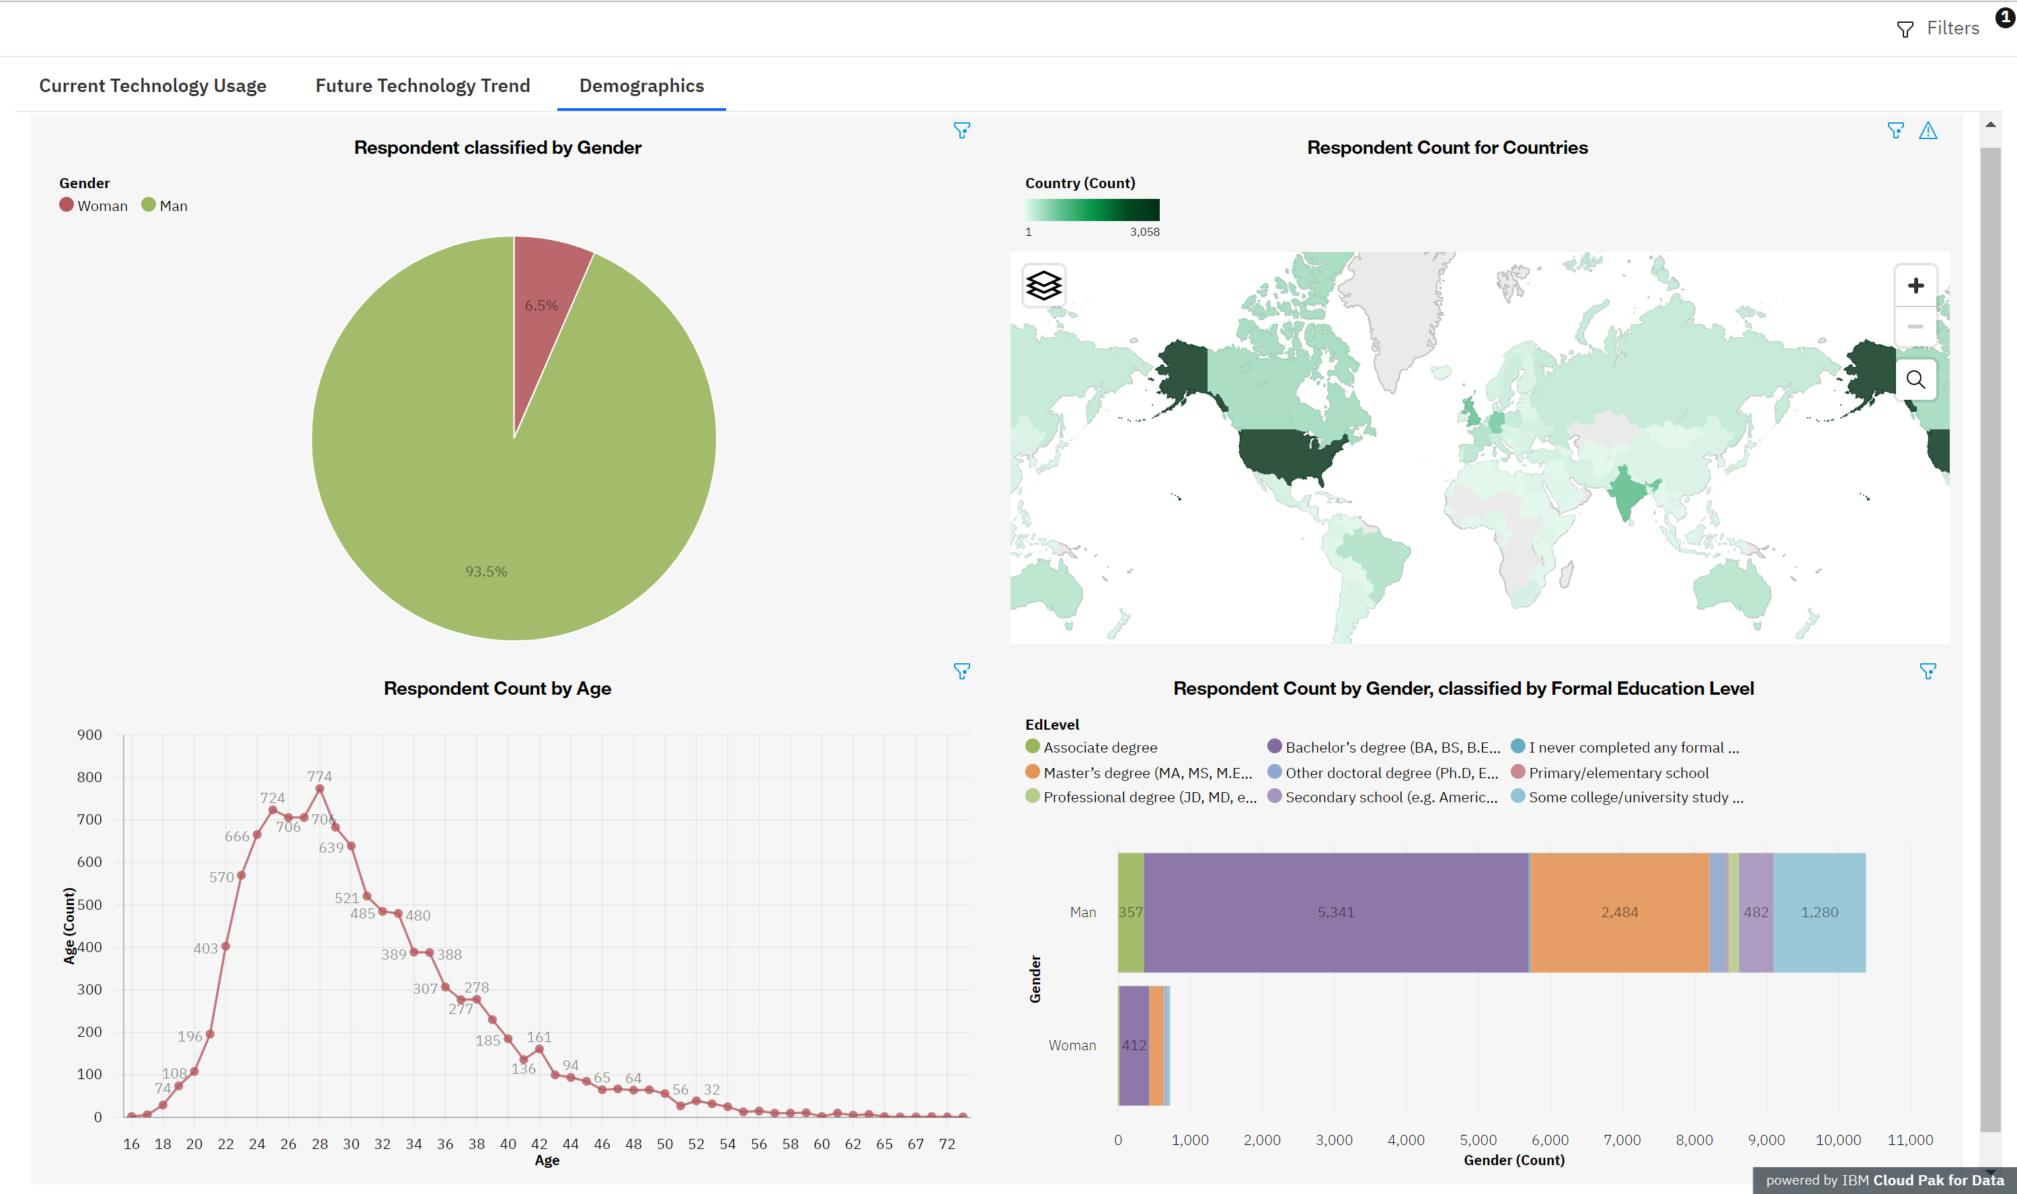
DASHBOARD C: DEMOGRAPHICS

Slide 15

DISCUSSION
The findings yield insights into the following questions:
What are the top programming languages in demand and their future trend?
What are the top database skills in demand and their future trend?
Team of consultant with which skill will be needed?
Which trainings should you provide to your employees?
Should you train your existing team of consultants or hire new team of consultants?

Slide 16
OVERALL FINDINGS & IMPLICATIONS
Findings
JavaScript and HTML/CSS are the most used languages for this year and the next.
Increase of interest in Python and TypeScript.
Increase of interest in PostgreSQL, MongoDB, Redis and Elasticsearch.
Implications
Since Web Development languages are the most used programming languages among developer, Web development is still in high demand.
Increase usage of Python might be due to increasing demands in Data Science, Deep Learning AI and Machine Learning.
Increase usage of NoSQL databases as it is more scalable, provide superior performance and are easy for developers to work with. Apart form these it might also be due to growing needs to handle big unstructured data.

Slide 17

CONCLUSION
Since Web Development is high in demands, team of consultants who are proficient in web development languages such as JavaScript and HTML/CSS are needed.
If we already have enough teams, we need to provide Typescript (superset of JavaScript) training to them as it is gaining popularity in following year.
If we do not have a team of consultants who are proficient in Python and are Data Science/Deep Learning AI/Machine Learning Professional, we will need to hire them as it is increasing in demand in coming year.
Team of consultants who are proficient in PostgreSQL will need to be hire as it will increase in demands in next year.
Team of consultants who are proficient in NoSQL databases such as MongoDB and team of consultants proficient in real-time databases such as Redis and Elasticsearch will need to be hire.

Slide 18

APPENDIX: RESOURCE
The subset of 2019 stack overflow developer survey results dataset provided by IBM. Link: m1_survey_data
Two modified subset of original dataset provided by IBM for building a dashboard with Cognos Dashboard Embedded (CDE). Link: m5_survey_data_demographics.csv and m5_survey_data_technologies_normalised.csv
Json file contents of GitHub Jobs API. Link: Json file
Survey data regarding Popular Programming Languages provided by IBM. Link: Popular Programming Languages

Slide 19
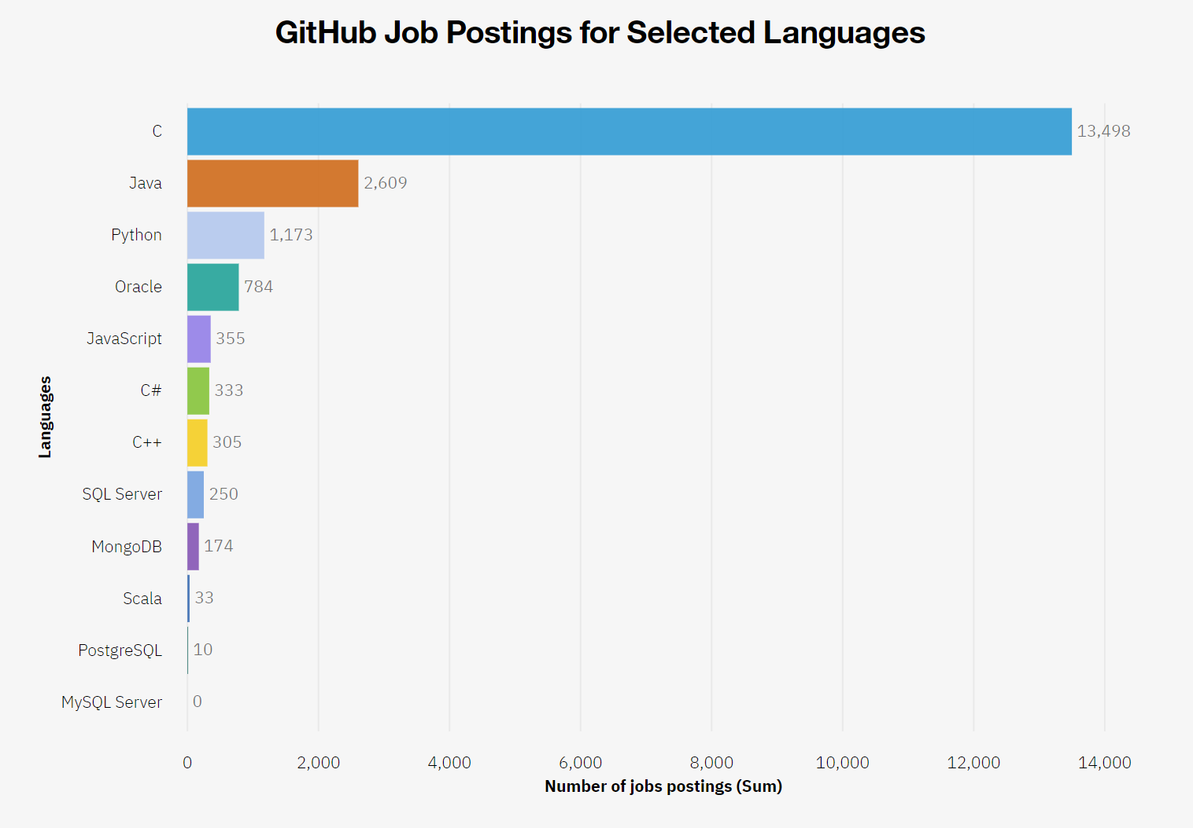
APPENDIX A: GITHUB JOB POSTINGS

Slide 20
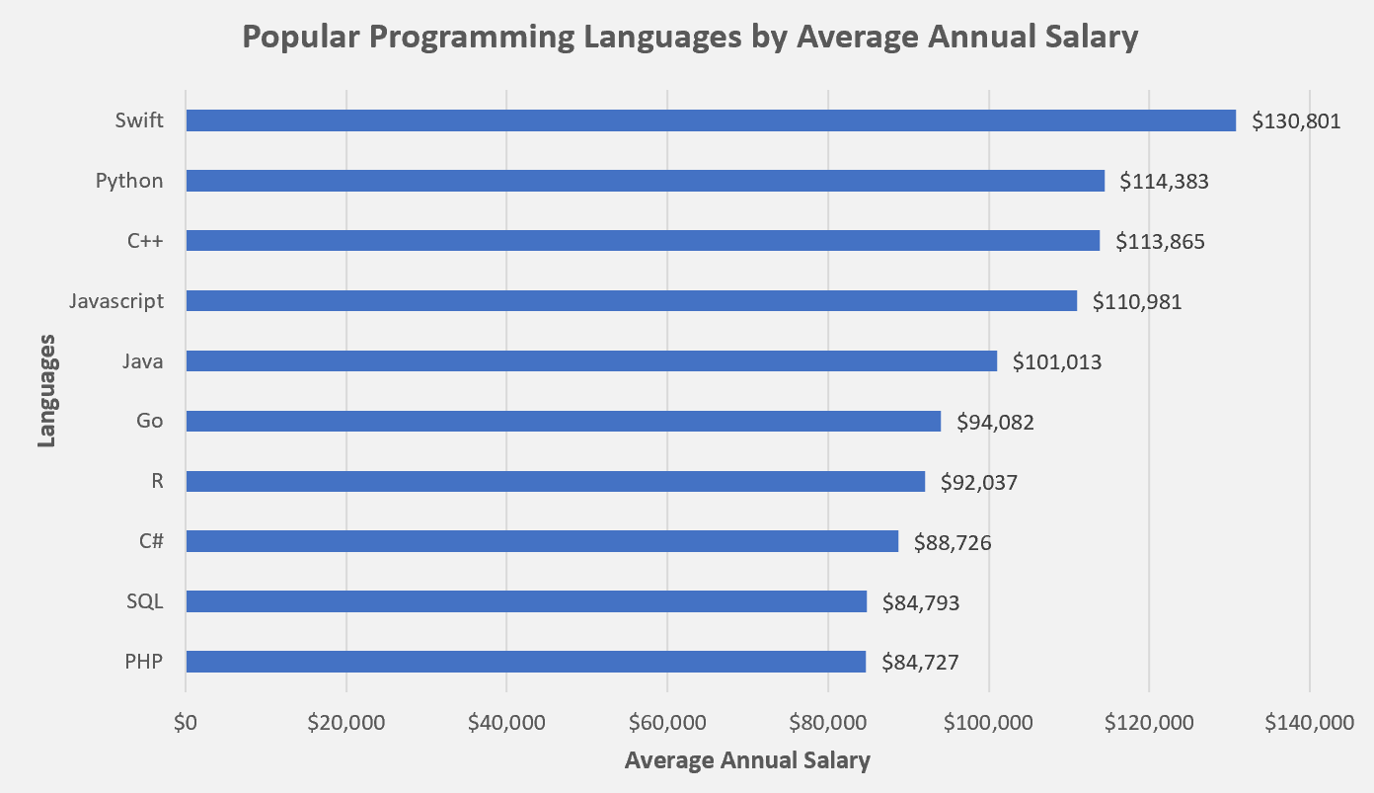
APPENDIX B: POPULAR LANGUAGES BY SALARY

